Slide 1
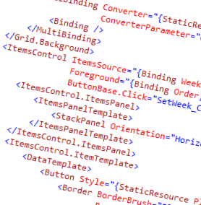
WPF and XAML
4 - User and Custom Controls

Slide 2
Overview
What is a control?
Components of a ContentControl

Slide 3



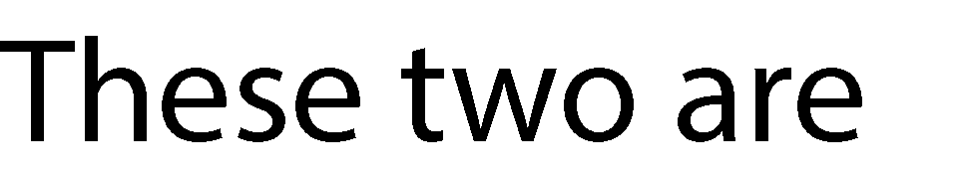



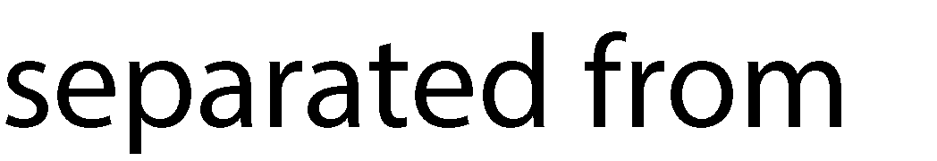
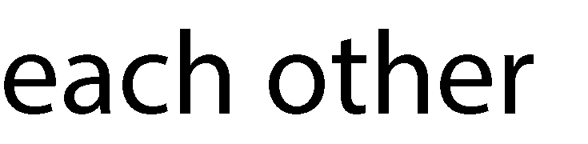
What is a control?
Control
Behavior
ControlTemplate
Components
Shape
ControlTemplate
Shape
Shape

Slide 4

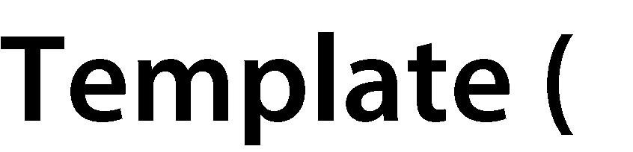


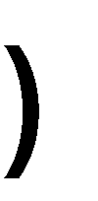




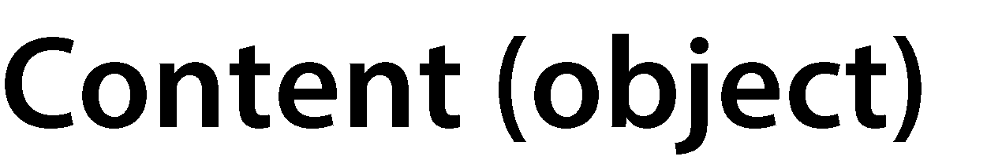

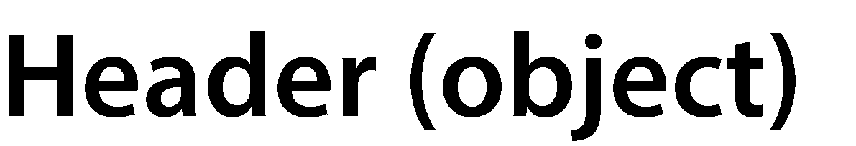











Components of a ContentControl

Slide 5
User Controls
You define the behavior and style
Can composite other controls
Great means of reusing visual elements

Slide 6
Summary
Controls separate behavior and visual elements
Visual can be replaced using a control template
You can start with UserControl which has any look and behavior you want to create

Slide 7
Demo
Demonstration of creating a control template
Create and reuse a user control

